Slide 1
MATLAB Matrices

Slide 2
MATLAB Row Vectors
A row vector is a one-dimension collection of data elements arranged horizontally. For example:
price_per_item = [ 1.50, 2.75, 0.99, 4.75, 10.25, 6.99, 0.49 ];
price_per_item(1) represents the first element (i.e., 1.50).
price_per_item(5) represents the fifth element (i.e., 10.25).
numel(price_per_item) returns the number of elements (i.e., 7).

Slide 3
MATLAB Column Vectors
A column vector is a one-dimension collection of data elements arranged vertically. For example:
number_of_items = [
6
4
15
3
1
2
12 ];
number_of_items(1) represents the first element (i.e., 6).
number_of_items(5) represents the fifth element (i.e., 1).
numel(number_of_items ) returns the number of elements (i.e., 7).

Slide 4
MATLAB – Element by Element Multiplication
In MATLAB, the two-character .* operation performs element by element multiplication. For example:
cost_per_item = price_per_item .* number_of_items;
Using the values in the previous slides:
cost_per_item = [ 9.00, 11.00, 14.85, 14.25, 10.25, 13.98, 5.88 ];
total_cost = sum(cost_per_item);
In this case, total_cost = 79.21

Slide 5
MATLAB – Dot Product
If we take two vectors (row and/or column) A and B both containing the same number of elements, this computation:
sum( A .* B );
occurs often in math, science and engineering. Therefore, it’s given a special name: dot product. A trigonometric presentation of the dot product’s relevance to physics is given at this website:
www.mathisfun.com/algebra/vectors-dot-product.html

Slide 6
MATLAB – Vector Multiplication
Use of the dot product is so common to solving real-world engineering problems, that MATLAB defines the single character * operator as meaning “compute the dot product”. MATLAB also has a built-in function “dot” which will compute the dot product of two vectors.
dot_product = A * B;
dot_product = dot(A,B);
total_cost = price_per_item * number_of_items; total_cost = dot( price_per_item, number_of_items );

Slide 7
Definition of Multiplicative Inverse
In normal algebra the multiplicative inverse of a number (a.k.a. the reciprocal) is that value which when multiplied times the number yields the value of 1. For example:
So, in normal algebra the multiplicative inverse of a value is 1 divided by that value.

Slide 8
Matrix Algebra – Definition of Inverse
In matrix algebra, if M is a square matrix, the multiplicative inverse M⁻¹
is defined as:
M * M⁻¹ = I
Where I is the Identity matrix. One can also prove:
M⁻¹ * M = I

Slide 9
Simultaneous Linear Equations
Linear equations represent a proportional relationship between several variables. For example, these linear equations represent two different relationships between the variables X and Y:
Y = 2 X + 3 Y = - X + 10
Sometimes, a set of linear equations represent relationships which must all be true at the same time. The values of the variables which simultaneously satisfy all the equations is called the solution. One can use algebraic substitution to solve this simple set of equations:
2 X + 3 = -X + 10 3 X = 7 X = 7 / 3 = 2.333 and Y = -2.333 + 10 = 7.667

Slide 10
Simultaneous Linear Equations
Consider this set of 3 linear equations with 3 unknowns:
5 X + 3 Y – Z = 10
3 X + 2 Y + Z = 4
4 X - Y + 3 Z = 12
Even though algebraic methods can be used to solve this set of simultaneous linear equations, it becomes considerably more difficult as the number of equations and unknowns increases.

Slide 11
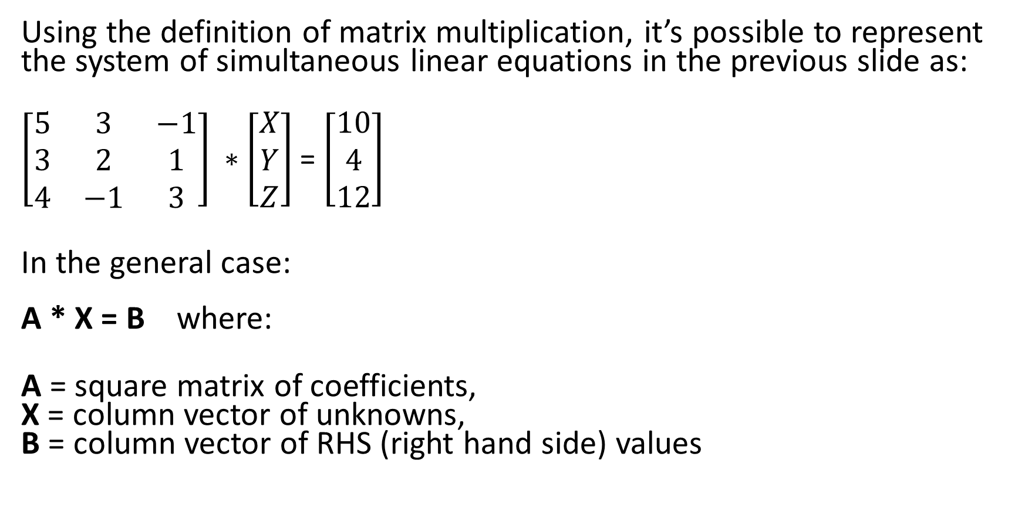
Linear Equations – Matrix Representation
Using the definition of matrix multiplication, it’s possible to represent the system of simultaneous linear equations in the previous slide as:
$\left[\begin{matrix}5 & 3 & −1 \\ 3 & 2 & 1 \\ 4 & −1 & 3\end{matrix}\right] ∗$ $\left[\begin{matrix}X \\ Y \\ Z\end{matrix}\right]$ = $\left[\begin{matrix}10 \\ 4 \\ 12\end{matrix}\right]$
In the general case: A * X = B where:
A = square matrix of coefficients, X = column vector of unknowns, B = column vector of RHS (right hand side) values

Slide 12
Linear Equations – Matrix Solution
Start with the linear system represented in matrix form:
A * X = B
Matrix multiply both sides by A⁻¹ (the matrix inverse of A) and simplify:
A⁻¹ * A * X = A⁻¹ * B
I * X = A⁻¹ * B
X = A⁻¹ * B
Using matrix algebra, the column vector of unknowns can be found by taking the inverse of the coefficient matrix and (matrix) multiplying it by the column vector of RHS (right hand side) values. If the coefficient matrix is not invertible, then the linear system has no solution (i.e., it is an incorrectly formed system.)

